Slide 1
The Nature of Spatial Data
Cynthia Rudin | Computer Science and Electrical and Computer Engineering, Duke

Slide 2
Spatial data
data from gadgets: cell phone data and mobile marketing, smart watch data, augmented video game data
environmental sciences like geology, biology, hydrology
some industries that deal with land use, like oil exploration, or agriculture, or real estate price estimation
physical networks like the power grid or the internet, or natural gas, or transportation
Hotspot data like crime data, which is one of our examples
Notes:
let’s start with these data, these are just an example of spatial data. *click* These are *Read*

Slide 3
What will we do with spatial data
Map it
Density estimation
Prediction: Classification, regression/interpolation

Slide 4
Spatial Analysis
Applications where spatial analysis has come in handy:
Estimating the risks of electrical grid failures in NYC.
Estimating which areas are at risk for crime (hotspots)
Estimating
Notes:
let’s start with these data, these are just an example of spatial data. *click* These are *Read*

Slide 5
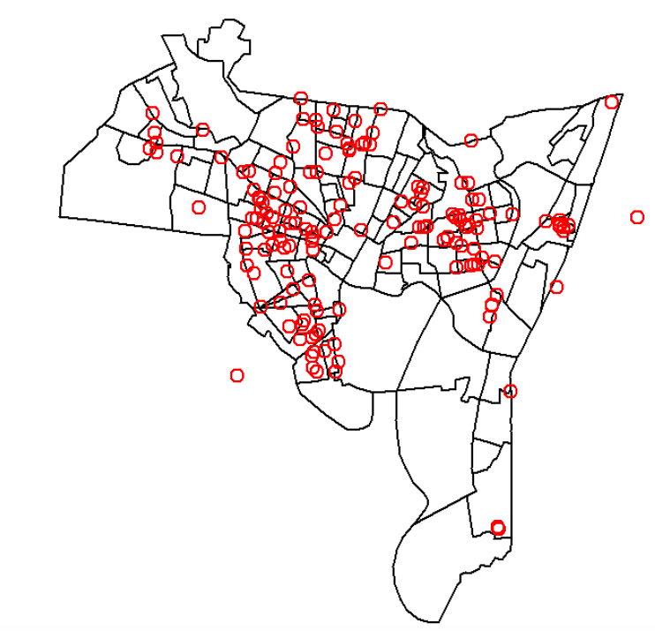
Spatial Data Has Specific Characteristics
Forced Entry Burglaries in New Haven CT, Sept 2014
Notes:
let’s start with these data, these are just an example of spatial data. *click* These are *Read*

Slide 6
“Point” data
crime | location
1 | 41.296001, -72.924335
2 | 41.297983, -72.923498
3
4
5
6
:
Notes:
Now this is just point data, where we get a list of points, and what the location of each point is.

Slide 7
“Point” data
“Raster data” – a table with counts of points in each cell
Neighborhood | Count
East Rock | 10
Edgewood | 3
Prospect Hill | 7
: | :
Notes:
Sometimes you can’t get the detailed point data and you only get raster data. “Raster data” is a table with counts of points in each cell.
Raster data gives you a summary of counts of what’s going on in each neighborhood. But it doesn’t tell you where each point is.

Slide 8
“Point” data – things to think about
crime | location
1 | 41.296001, -72.924335
2 | 41.297983, -72.923498
3
4
5
6
:
Clumpy – not uniformly distributed
Are these all the crimes that happened in New Haven in 2014?
What if some neighborhoods systematically underreport crimes?
Notes:
Here are some things to think about. First,*click* the data are not randomly distributed, they are sort of clumpy, *go back*There are some neighborhoods with more crime than others. Also *click* are these all the crimes that happened in New Haven that month? Sometime the data can be missing or irregularly sampled. *click* what if some neighborhood systematically underreport crimes? Very often people don’t report crimes for some reason. Perhaps they don’t’ want the police to come into their house because they are doing something illegal themselves. Who knows.

Slide 9
“Point” data
How to compute distances between 2 crimes?
Physical distance
Notes:
One thing we’ll need to be able to do is to compute the distance between 2 crimes. We’ll need that for a lot of algorithms. So how do you report distance between 2 crimes? You might try to use physical distance, which is just euclidean distance, or they say “as the crow flies” distance, but but physical distance might not be the best way to report. Why not? What if…

Slide 10
“Point” data
How to compute distances between 2 crimes?
Physical distance
Notes:
This were a set of streets, but the pathway from one house to the next was blocked by a fence, or some other wall. Then it would look in the data like these two houses were near each other *click* when they are actually very far away. If these two houses were robbed, I would not expect they were necessarily robbed by the same person. Now what about these two houses here? *click* These are the same physical distance apart as the other two houses, but if these two houses were robbed, I would definitely try to figure out whether they were robbed by the same person.

Slide 11
“Point” data
How to compute distances between 2 crimes?
Physical distance
Driving distance / Walking distance
Adapted to the local area (crimes in same apt building might be the same “distance” as crimes on the same suburban block)
Notes:
So physical distance might not be the best way to report distance. Well, we could try computing driving distance, or if it’s in a city, we could compute walking distance. Or we could choose some mix of distances that is adapted to the local area. For instance, we should say that crimes in the same apartment building are the same “distance” (however we define it) as crimes on the same suburban block. There’s a lot of flexibility in how you define distances.

Slide 12
Distance matrix
 | Crime 1 | Crime 2 | Crime 3 | Crime 4 | Crime 5 | …
Crime 1 | 0 | 3.329 | 1.309 | … | …
Crime 2 | 2.463 | 0 | 2.235 | … | …
Crime 3 | 1.125 | 2.376 | 0
Crime 4 | : | : | :
Crime 5
:
Notes:
Now usually, we need a matrix of distances between all pairs of points. So the entry in this table here is just the distance between two crimes. If you have this then you’re good to go for a lot of spatial analysis techniques. Obviously you can’t compute this for all problems because you might not have a finite number of entities to compute distances on.

Slide 13
Coordinate Systems
Try not to get confused between state plane coordinates and gps coordinates.
I do not advise computing Euclidean distances along the earth by hand. The earth is curved. Use a built-in tool.
Visualization helps to sanity check
Notes:
Now I have to warn you about this. Half the time when you get some spatial data, it is not in gps coordinates. That’s bad. There are many different coordinate systems out there, and a lot of time you will get data in the most obscure coordinate system you can imagine. You’ve got to find a way to convert the coordinates to gps. Otherwise you’re stuck, and you can’t plot anything, *click* I don’t advise you to try to compute distances by hand using any coordinate system, because the earth is curved, and your distances will be all wrong. So use a built-in tool to calculated distances between points. Also *click* *Read* actually when we were working with NYC data we had a lot of typos where we would see that some part of nyc’s electrical grid was in the middle of the east river. It’s kind of funny but also, you know, having that kind of noise in the data is very sad. So you have been warned.

Slide 14
Space-time data
crime | location | time
1 | 41.296001, -72.924335 | 1:30pm
2 | 41.297983, -72.923498 | 5:00pm
3 |  | 8:10pm
4 |  | 9:00pm
5 |  | 2:25pm
6 |  | 6:00am
: |  | :
Notes:
All right, You could also get space time data, where each point comes with a location. I will be honest in that most of the spatial data I get also has time. Crime data, disease spread data, marketing data, and so on. All of them – it’s a place, and a time, when something happens.

Slide 15
Labeled data
-
Ad | location | label
1 | 41.296001, -72.924335 | +
2 | 41.297983, -72.923498 | -
3 |  | +
4 |  | +
5 |  | +
6 |  | -
: |  | :
-
+
-
+
-
-
+
-
+
+
+
+
+
-
-
-
+
Notes:
You could also get data that are labeled, so you’ll get a location and then maybe a time, and then you’ll get a “yes” or “no” for each point. Like maybe each point is labeled with a plus or minus depending on whether someone clicked on a mobile ad at that location. Then you want to predict for a new location whether someone will click.
Or you could get real valued labels too. And you could do regression. That’s totally plausible.

Slide 16
KDE

Slide 17
Kernel Density Estimation
crime | location
1 | 15
2 | 12
3 | 10
4 | :
5 | :
6
:
Notes:
Let us say that you have point data. But only along one street. So crime 1 happens at location 15, crime 2 happens at location 12, and so on. We want to know how likely it is to have a crime at a particular place along the street. In other words we want to estimate the density of crimes along the street. So we’re going to assume that crimes happen in the future in similar places to where they’ve happened in the past, and we’ll place a bump on each crime that has happened *clicks while talking*, and we’ll add all the bumps up.

Slide 18
Kernel Density Estimation
crime | location
1 | 15
2 | 12
3 | 10
4 | :
5 | :
6
:
Notes:
And it looks sort of like that. It’s a good density estimation model.

Slide 19
Kernel Density Estimation
crime | location
1 | 15
2 | 12
3 | 10
4 | :
5 | :
6
:
Notes:
Now we have some flexibility in the size of the bumps. We could have chosen narrower bumps or wider bumps. If we chose wider bumps, our kernel density estimate will be smoother, and if we chose narrower bumps, the kde estimate will be peakier. Let’s try that.

Slide 20
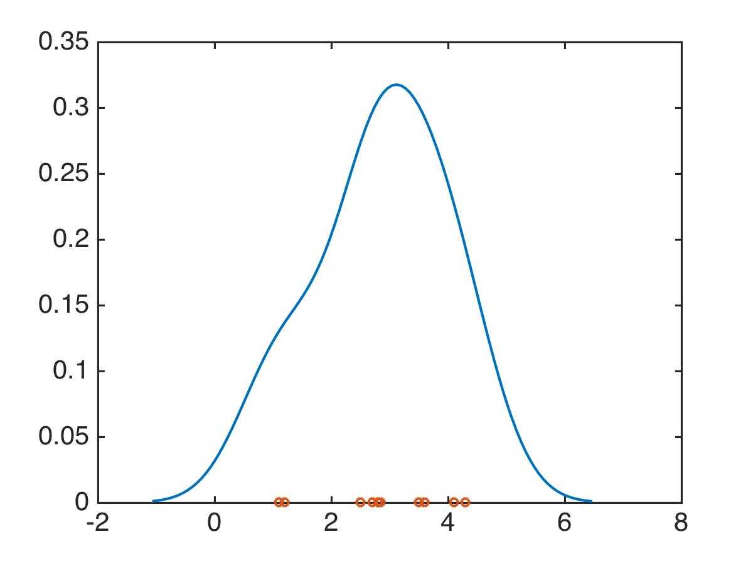
KDE bandwidth just right
Notes:
So here, I chose the kde bandwidth to be just right, Nice and smooth, and since I don’t have much data it doesn’t try to overfit and create lots of peaks.

Slide 21
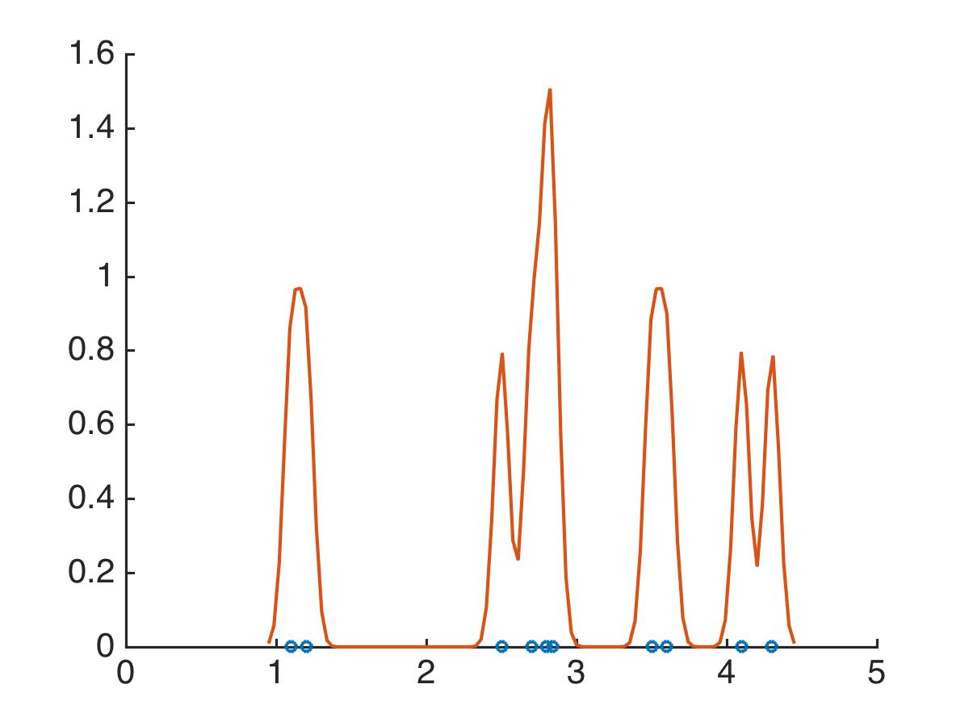
KDE bandwidth too small
Notes:
this is what happens when I make the bandwidth too small, I get these very overfitted peaky density estimates.

Slide 22
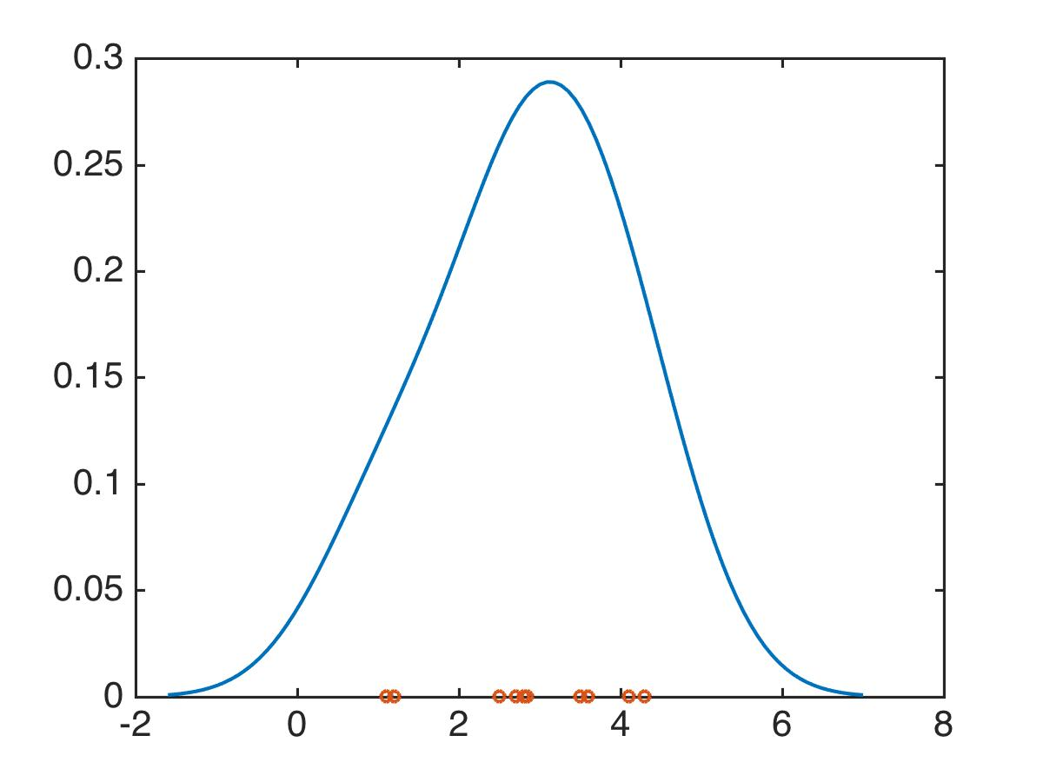
KDE bandwidth too big
Notes:
And here it’s too big, too smooth, no details left.

Slide 23
Kernel Density Estimation
crime | location
1 | 15
2 | 12
3 | 10
4 | :
5 | :
6
:
Notes:
This is the formula for what I just did. I’m *adding up* a bunch of bumps, where each bump is *click* a kernel, that looks like this, *click*

Slide 24
Kernel Density Estimation
crime | location
1 | 15
2 | 12
3 | 10
4 | :
5 | :
6
:
Notes:
or that *click*

Slide 25
Kernel Density Estimation
crime | location
1 | 15
2 | 12
3 | 10
4 | :
5 | :
6
:
Notes:
or this, and the kernels *click* are centered at each of the x_i’s *point* and the kernels are scaled by the bandwidth h, which makes them wider or narrower.

Slide 26
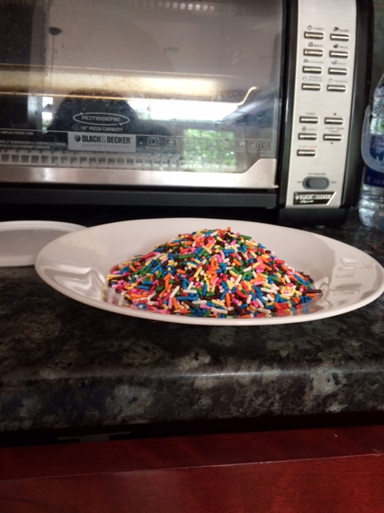
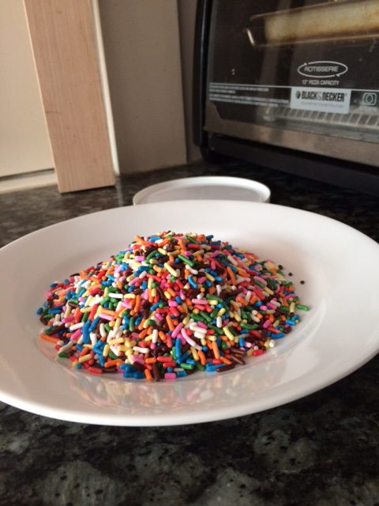
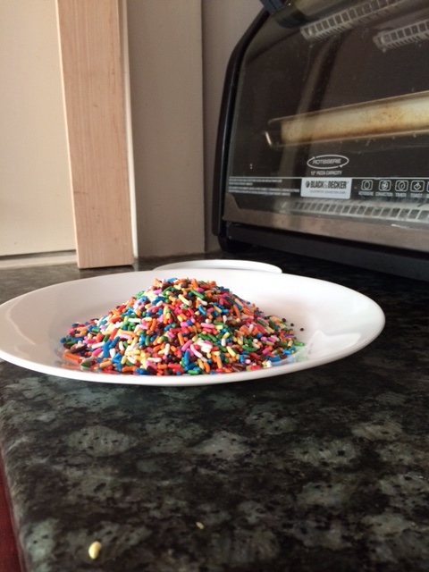
Kernel Density Estimation
Multidimensional kernels work too.
Notes:
Now I just showed you kde for 1 dimension, but you can do it for multiple dimensions too, where the kernels look like these piles of sprinkles. You can actually choose the kernel to be whatever function you want, but mainly people use the formula for the gaussian pdf.

Slide 27
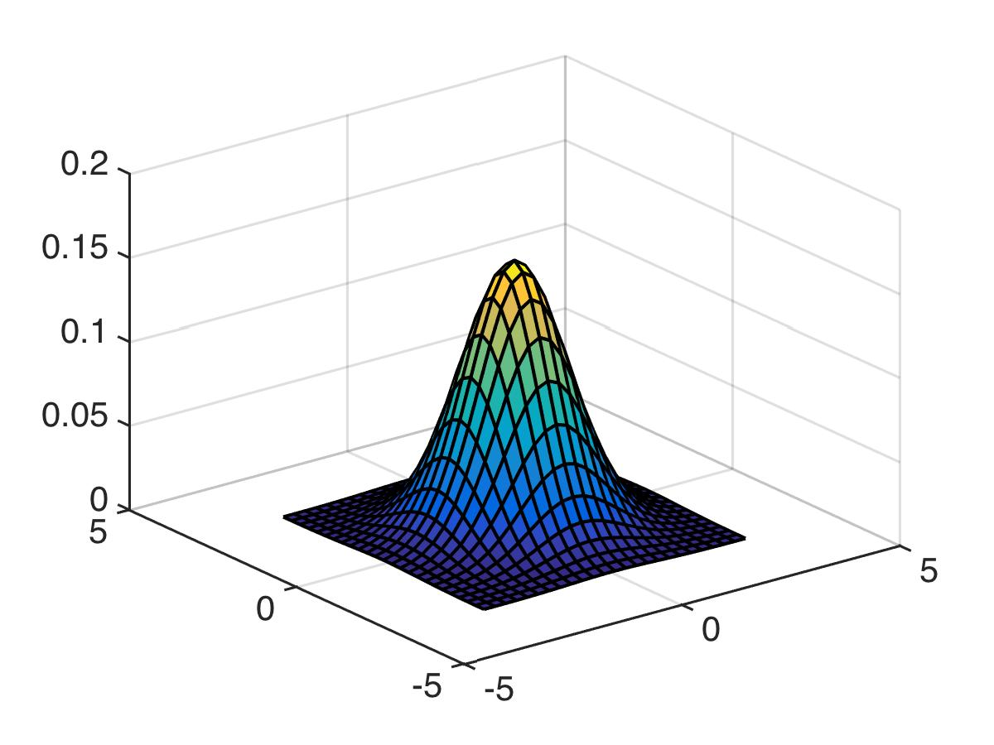
Kernel Density Estimation
Multidimensional kernels work too.
Notes:
The more boring picture of the gaussian pdf looks like this.

Slide 28
Kernel Density Estimation
The go-to method for density estimation
“Nonparametric” (means there’s a bump on each point)
Tricky to use anything other than Euclidean distance
Notes:
*read2* And I will warn you that with kde since it often uses the gaussian kernel that it expects a roundish bump, which means it’s kind of tricky to use anything other than natural physical distance.

Slide 29
K Nearest Neighbor (KNN)

Slide 30
K Nearest Neighbor (KNN)
Amongst the simplest of all machine learning algorithms. No explicit training or model.
Can be used both for classification and regression.
Use x’s K-Nearest Neighbors to vote on what x’s label should be.
Notes:
*read2* and the technique is so simple that I can describe it on one line. If you want to make a prediction at point x, you just find X’s K nearest neighbors, and take the majority vote to determine what x’s label should be.

Slide 31
KNN
-
Ad | location | label
1 | 41.296001, -72.924335 | +
2 | 41.297983, -72.923498 | -
3 |  | +
4 |  | +
5 |  | +
6 |  | -
: |  | :
-
+
-
+
-
-
+
-
+
+
+
+
+
-
-
-
+
Notes:
So here’s an example of the format of the data. Let’s say you’re predicting whether someone will click on an advertisement shown to them on their mobile phone, and all you have are the locations where the ad has been shown in the past. I’m using the example of advertising data, but you could also have crime data, disease spread data, whatever, could be in this format. I put the road up just so you know I’m in physical space there, imagine I’m viewing people from above.

Slide 32
KNN
-
Classify using the majority vote of the k closest training points
1-NN: classify as +
2-NN: tie
3-NN: classify as -
-
+
-
+
-
-
+
-
+
+
+
+
+
-
-
-
+
Notes:
Now we’ll use KNN for classification at this new green spot. So I have to find the majority vore of the k closest training points. So if I’m doing 1 NN *clicks* Then since my NN is positive, I classify the green point as positive. If I’m doing 2-NN *clicks*, then it’s a tie. Hm, this is probably why you want to make k an odd number. And then if you are doing 3-NN *clicks*, you have 2 negatives out of the three, so the prediction is negative.

Slide 33
KNN for regression
Predict using the average label of the k closest training points
1-NN: value is 5
2-NN: value is 6
3-NN: value is (5+7+9)/3=7
3
9
2
3
1
1
9
2
6
7
7
3
3
5
2
7
Notes:
And for regression the deal is exactly the same. So maybe here we’re trying to predict how many purchases each household will make of some type of product next year, like a smart watch or something. So here the 1nn prediction is 5, the 2nn prediction is 6 because it’s the average of 5 and 7, and then the 3NN value is 7 which is the average of these three numbers. So nice and simple, KNN.

Slide 34
Making K-NN More Powerful
K controls overfitting
K too small: we’ll model the noise
K too large: neighbors include too many points from other classes
Can use a distance-based voting scheme, where closer neighbors have more influence.
The distance measure has to be meaningful. Attributes should be scaled.
Eg. Income varies 10,000-1,000,000 while height varies 1.5-1.8 meters
+
-
+
-
-
+
-
+
+
-
+
-
-
+
+
-
+
Notes:
Just some minor insights about KNN. *click* The parameter K – controls overfitting. *read* So we have to figure out how to choose K. Possibly cross validation can help. *click* Knn doesn’t take into account how far away your nearest neighbors are. So – let’s say youre doing 5NN. Even if your fifth nearest neighbor is very far away, it gets an equal vote in 5NN. You could actually change that, so that points get to vote according to how far away they are from the point you’re trying to classify. *click*
Another major factor in the effectiveness of Knn is the distance measure you’re using. Because if you change how you measure distances, it’s possible that who your nearest neighbors are could change. Here’s an example of a bad distance metric. In this case, the units of two features are completely different, but we’re using Euclidean distance – this is a really bad thing to do. Here, *click* income varies over this huge range, while height only varies in a very small range. So what happens is that the point when you plot them look something like this. Then when you go to compute your NN, you will basically just ignore the distances in the height direction, which is horizontal, and you’ll only pay attention to the income, which is on the vertical axis. The closest points are the ones closes in the vertical direction. Which is not what you intended. Which is why the distance measure here is not meaningful. It’s easy to fix though, just normalize the feature values.

Slide 35
Pros/Cons to K-NN
Pros:
Simple and powerful. Can be used instead of any classification/regression technique.
No training involved (“lazy”). New training examples can be added easily.
Interpretable
Cons:
Expensive and slow: O(md), m= # examples, d= # dimensions
To determine the nearest neighbor of a new point x, must compute the distance to all m training examples. Runtime performance can be slow, but can be improved.
May rely heavily on correct scaling of the coordinates.
Notes:
So Knn has a lot of plusses. It’s simple and powerful, and you can use it instead of any classification or regression technque. There’s no training involved. All the calculations are done when you go to label a new point. This means you can add new training examples and you don’t actually have to do anything with them, you just use them whenever they are a nearest neighbor. I really like Knn because it’s interpretable. You can find out exactly why a prediction is what it is, because you can just look at the neighbors. *click* the cons are the it’s expensive at runtime because you have to find the nearest neighbors and that requires a lot of pairwise comparisons. But if you organize the training examples in structures that allow fast access, or compute distances only approximately, it does speed things up. *click* and as I told you before, if the coordinates are scaled badly, it messed up the distance metric. You can undo the scaling, but you have to know the problem is there first.
Pre-sort training examples into fast data structures
Compute only an approximate distance
Remove redundant data (condensing)

Slide 36
Spatial Poisson Processes

Slide 37
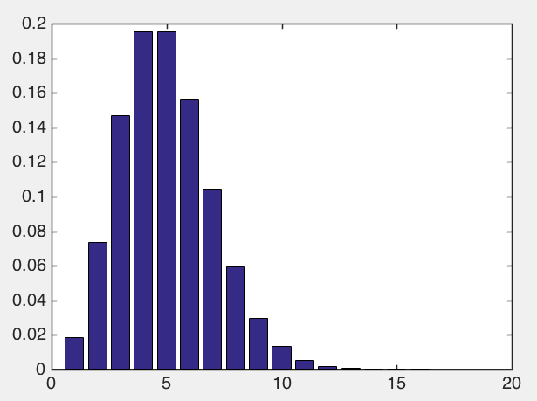
Spatial Poisson Processes
Recall the Poisson distribution:
Probability
Notes:
Let’s start with the Poisson distribution. *clicks* There’s the pmf. *click* and there’s the notation that says that our rv X is poisson with rate parameter lambda. I’ll write out the pmf right there. *click* You don’t really need to remember this formula, I never do, I just remember *click* that the center of it is lambda, and the variance is lambda too. So if you tell me that the number of emails I get hourly follows a Poisson distribution with parameter 10, I know I get 10 emails an hour on average, with a spread of 10 emails also.
https://en.wikipedia.org/wiki/Poisson_point_process

Slide 38
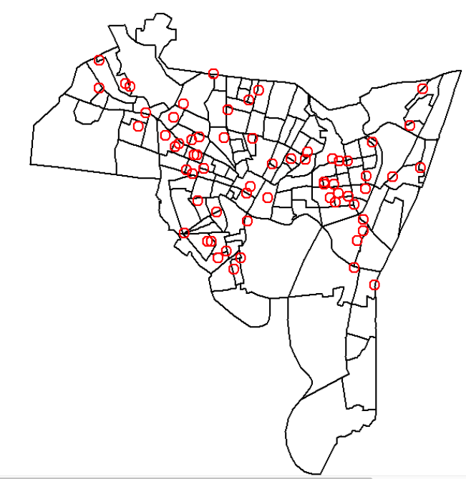
Spatial Poisson Processes
Pick any region B. Pick a number of crimes n.
Should depend on size of B
Should depend on value of n
Should depend on rate of events λ
B
Homogeneous Point Process with parameter λ
Notes:
Let us say that we want to model the rate of crimes occurring in some month in area B. Pick region B, and pick number of crimes n, and you want to know *click* how often does the number of crimes in B equal n? In other words *click* what is the probabilty that the number of crimes in area B is exactly n? Now, what quantities should this probability depend on? Well, *click* it should depend on the size of B. If you have a larger region we expect more crimes. It should also depend on n. *click* If n is waaay above the average, then we’ll almost never get n crimes very often. If n is average, the probability to get that many crimes is higher. Also *click* it should depend on the event rate. If events are rare, then we won’t get n events very often when n is large. So now let me write down the actual formula, and you can check whether it depends on these 3 things. And it does *ad lib*. This is called *click* a homogeneous poisson process. Now, this is very nice and all but there’s a major flaw in the reasoning here. This assumes that crimes can happen equally anywhere. But we know that’s not true for crimes, they are concentrated in certain places. So let’s keep trying. You see, if we want to model the crime rate as not being constant, then we must have that the rate of events lambda is not constant.

Slide 39
Spatial Poisson Processes
Pick any region B. Pick a number of crimes n.
Should depend on size of B
Should depend on value of n
Should depend on rate of events λ
B
Notes:
*click*

Slide 40
Spatial Poisson Processes
Pick any region B. Pick a number of crimes n.
Should depend on size of B
Should depend on value of n
Should depend on rate of events λ
Rate of events λ should depend on x₁,x₂
B
Inhomogeneous Point Process with parameter λ(x₁,x₂)
Notes:
So the rate of events should depend on where you are in space. And when this happens, when the rate depends on where you are, it’s called a “click* inhomogeneous point process, and now lamdbda is a function of where you are.

Slide 41
Spatial Poisson Processes
Pick any region B. Pick a number of crimes n.
B
Inhomogeneous Point Process with parameter λ(x₁,x₂)
Notes:
Ok so now for an *inhomogeneous* point process, how do we determine what the probability is to have n points in B? It’s not as easy as last time, because now we can have lambda changing even within region B. You could have a high crime area in there and also a low crime area. So what do you do to get that probability? And of course the answer is that you have to integrate the rate over all of region B.

Slide 42
Spatial Poisson Processes
Pick any region B. Pick a number of crimes n.
B
Inhomogeneous Point Process with parameter λ(x₁,x₂)
Notes:
*click* so there is the rate integrated over B. And so now we can get this probability *click* which is just the poisson distribution again, but with the rate being the integral over B this time.

Slide 43
Spatial Poisson Processes
Pick any region B. Pick a number of crimes n.
B
Notes:
Now when you are modeling data using an inhomogeneous poisson process, you need to choose what form lambda is going to have. Right, because you could choose lambda to be whatever you want. So you have to make some modeling decisions. You have to figure out exactly *how* lambda depends on position. Like perhaps (1) *click* lambda could be a linear model. That’s a bit weird if you think about it because it means lambda strictly increases along both x1 and x2. So maybe *click (2)* you could make lambda a polynomial instead, ok that’s fine. Or *click* maybe you could just model lambda using kernel density estimation, which is a nonparametric method. Whenever you put a bump at each point it’s called nonparametric. So here, we put a bump K on top of all the training points, the xi’s. And the bandwidth parameter is h, just like in kernel density estimation. You could really do whatever you like. So perhaps you think that lambda could be a function to the nearest drug house – you think that houses with more drugs have more crime or whatever. In any case, your job is to do the modeling, and the software packages job is to fit these models for you. You just have to tell it which model you want and it’ll use maximum likelihood and get the parameters, like a and b for the linear model. Maybe you can also set the kernel bandwidth parameter by fitting.

Slide 44
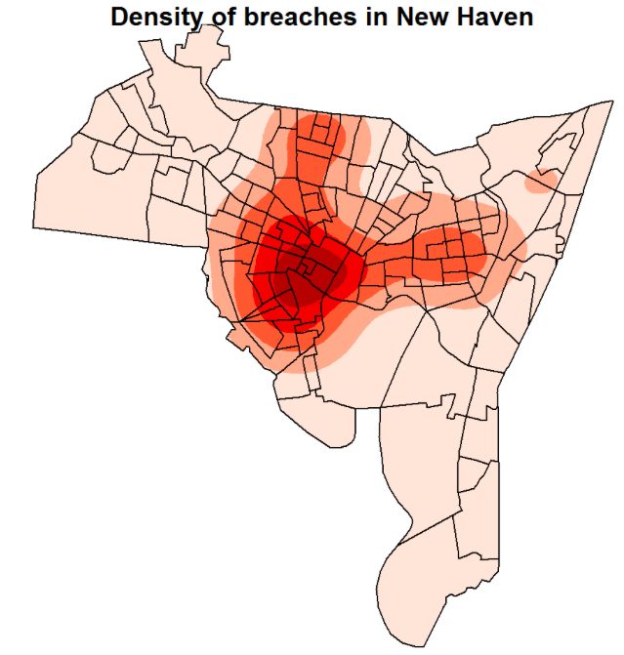
Spatial Poisson Processes
Notes:
and hopefully you get something like this and you’re happy about it.
So this kind of goes one step beyond just density estimation, because now you actually have a model for how the data are produced. So you can fit the parameters of the model. Unlike KDE. Again this is called an inhomogeneous point process.
https://en.wikipedia.org/wiki/Poisson_point_process#Homogeneous_Poisson_point_process

Slide 45
Variograms

Slide 46
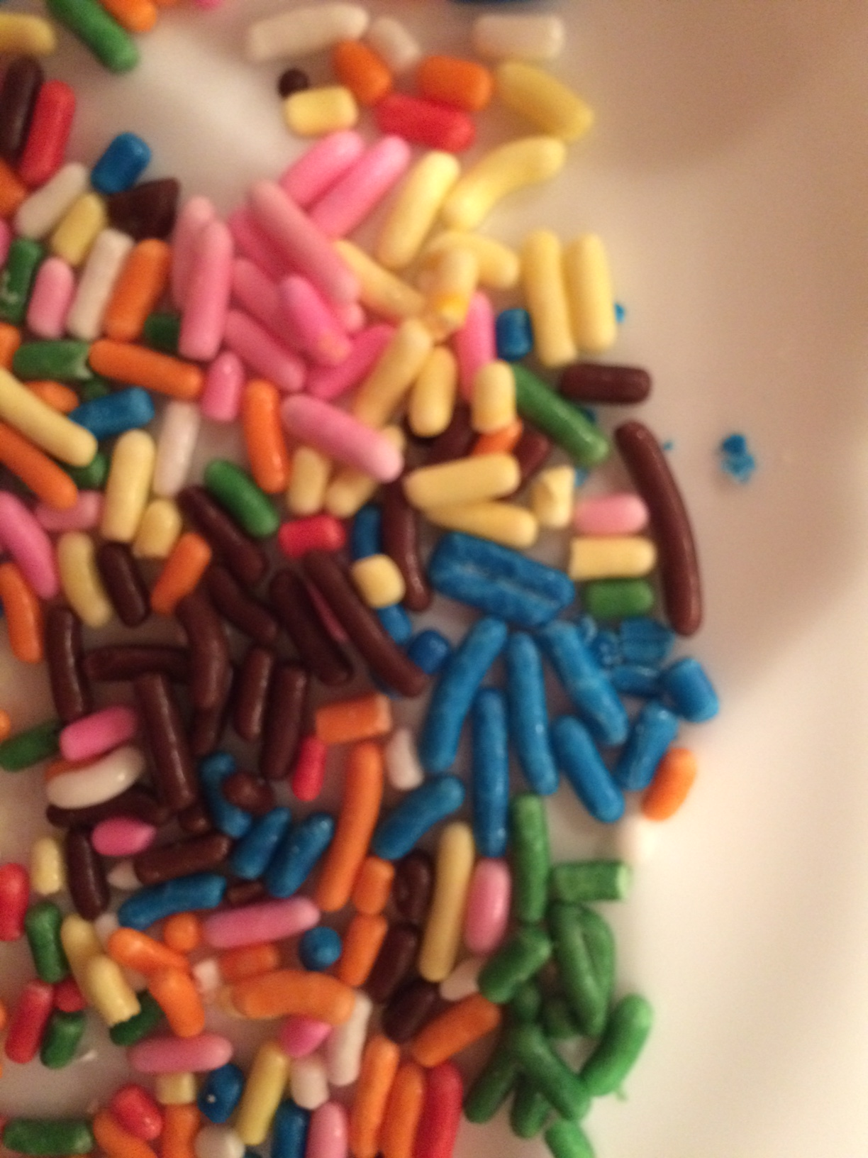
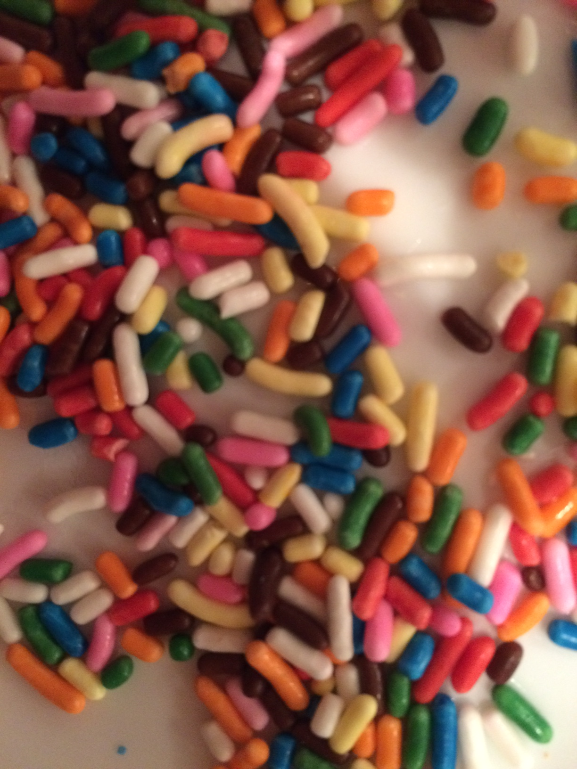
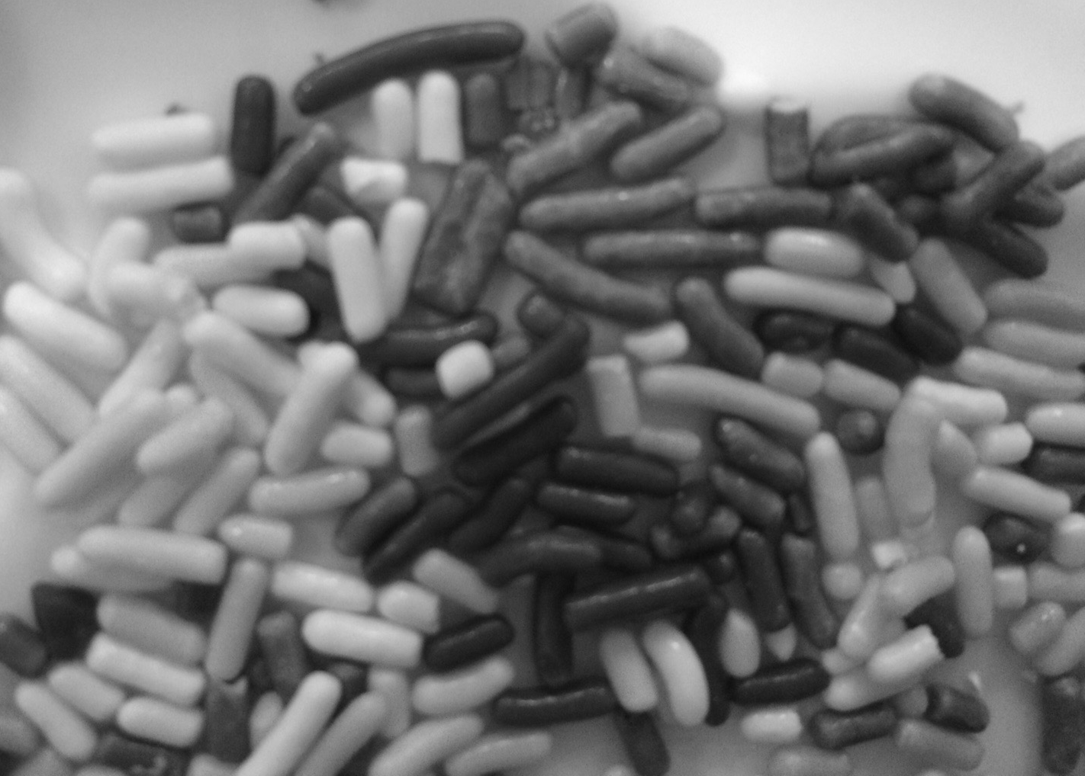
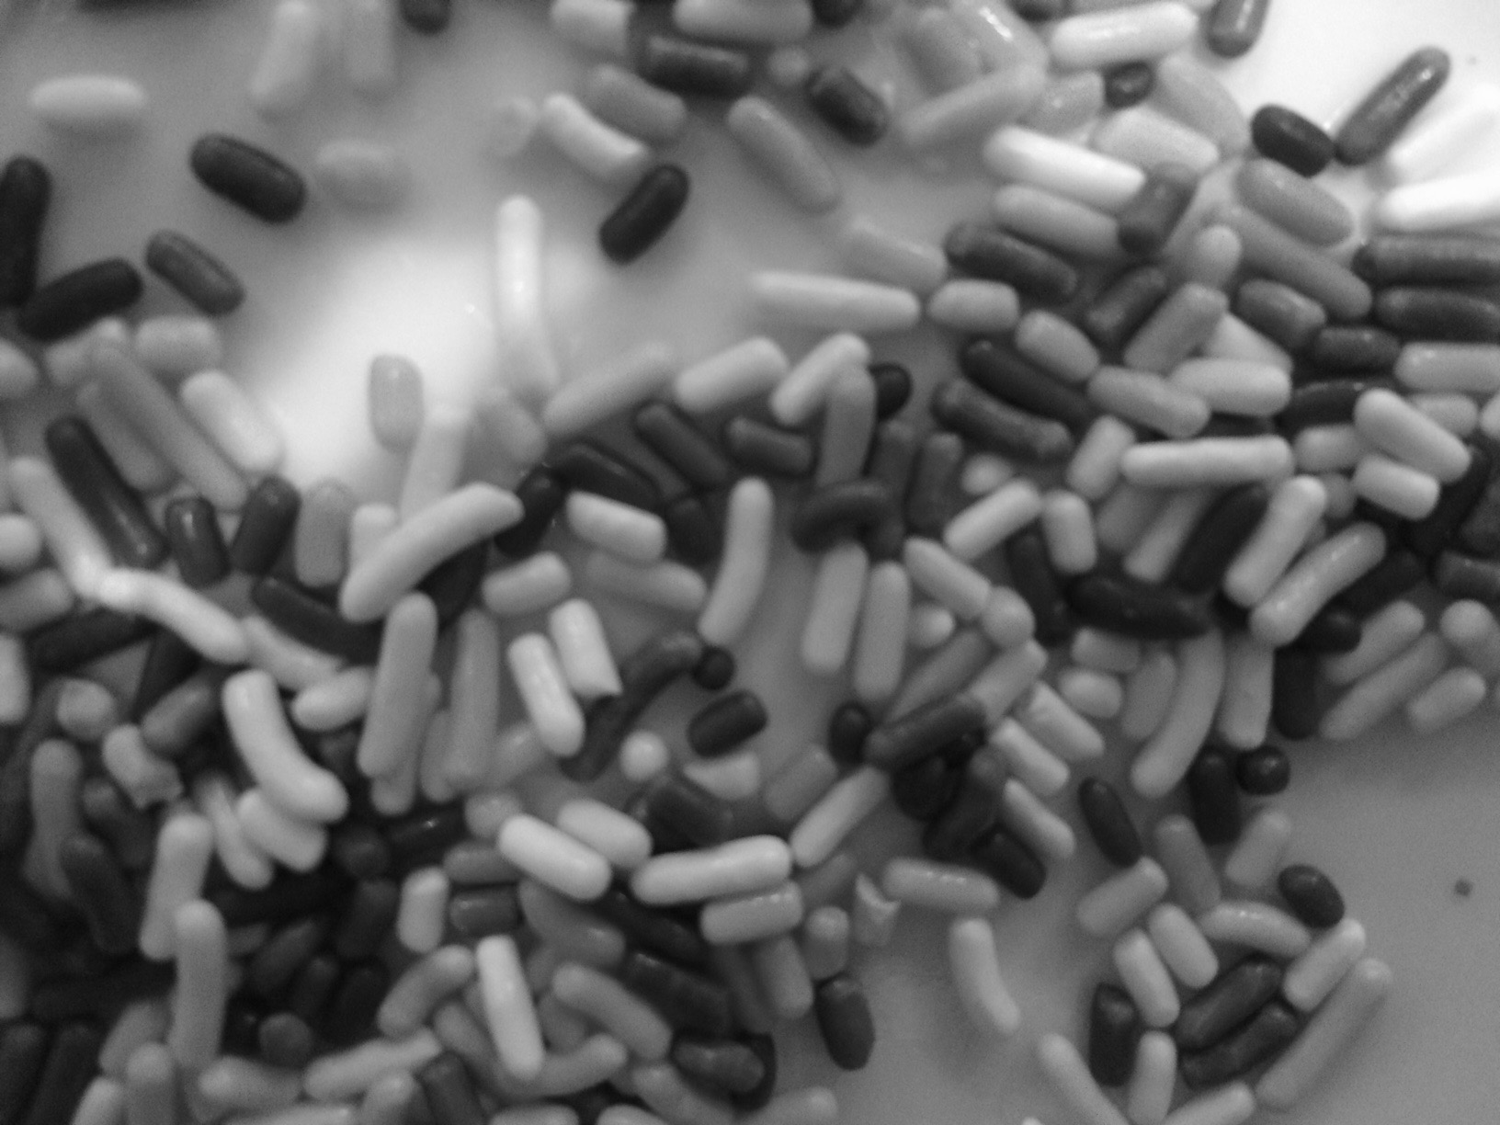
Variograms
Describes spatial correlations
In a way that histograms don’t.
Notes:
These are two pictures of sprinkles. You can see, I sort of organized the sprinkles here in this one. We have vanilla sprinkes and chocolate sprinkles. I like the chocolate ones better, so the darkness color here represents happiness.

Slide 47
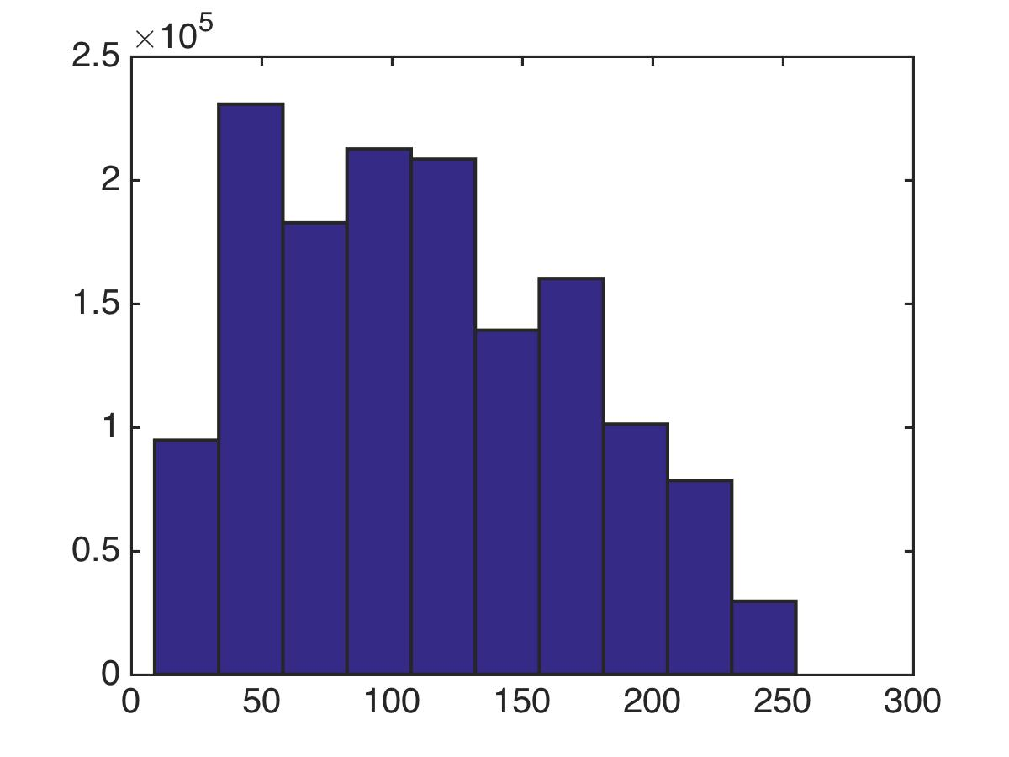
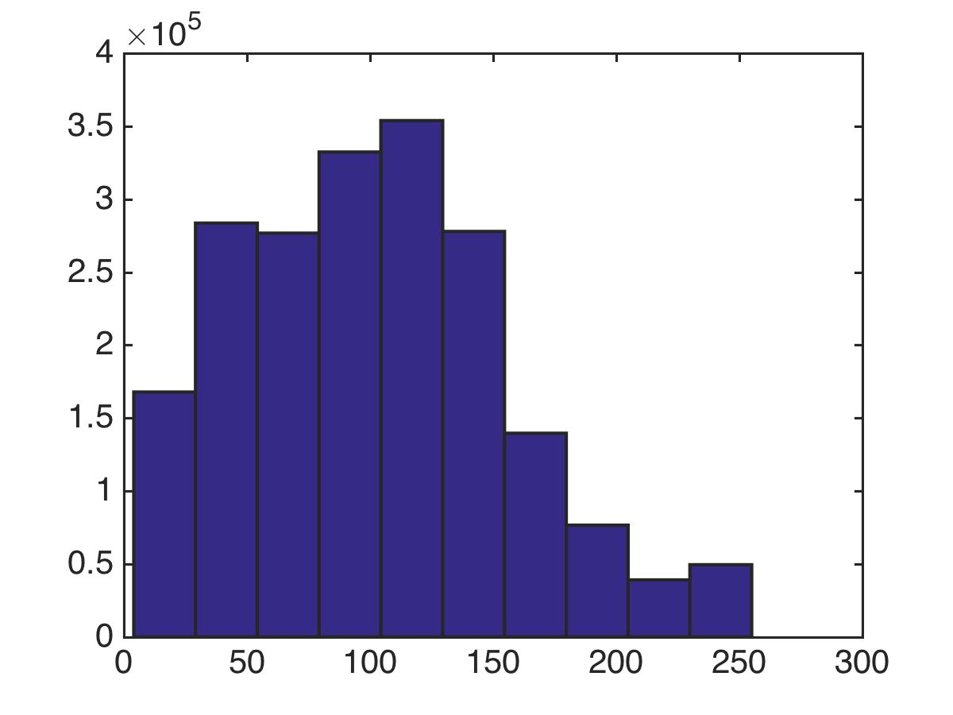
frequency
frequency
Histograms do not reflect that nearby points are more correlated
gray
gray
Notes:
If I computed a histogram of grayscale values on each of these images, it would look basically identical. The images have the same number of dark chocolate sprinkles, milk chocolate sprinkles, and vanilla sprinkles. So looking at a histogram, you wouldn’t be able to tell that in one of the two images, there are areas where the nearby sprinkles are similar.

Slide 48
variogram
variogram
Variograms show how much nearby points are correlated
nearby points are as correlated as far away points
nearby points are more correlated as far away points
distance
distance
Notes:
A variogram would be able to do this for you though. Variograms show how much nearby points are correlated. *click2* Here’s the variogram for these sprinkles, and you could see that it goes up and levels off very quickly. That’s because nearby points are as correlated to each other as far away points. But over here, if you go a little bit away from any point, you could still be correlated to the values at that point. So that’s why the variogram goes up smoothly. So you should think of a variogram as telling you how quickly the neighborhood changes as you walk away from somewhere.

Slide 49
Variogram
Variogram:
On average, how much does the label change at this distance?
Notes:
Now let’s define variogram precisely. *click read click read* y is the chocolate-y-ness level, or the happiness level, it’s the label at that the point. *click* this is the happiness level at this point here, which is where you walked delta x1 and delta x2 away from your initial point.*click* ok so that’s how far you walked, those are the lags in the 2 different directions. Are you ready for the definition of the variogram? *click* It’s the expectation of the change in chocolately-ness over the distance you walked. Squared. So if the neighborhood changes quickly as you move around, this thing is going to be large. If the neighborhood changes slowly, then this thing is not as large. So it’s just like we saw with the sprinkles. *click* there’s an unfortunate ½ in here, just to confuse you. And again the question it answers is on average, how much does the label change at distance delta away from where you started.

Slide 50
variogram
variogram
Variograms show how much nearby points are correlated
nearby points are as correlated as far away points
nearby points are more correlated as far away points
distance
distance
Notes:
So again, in this one since the chocolateness level changes a lot as you move away from a point, the variogram is large. And in this one, since the chocolateyness level changes a bit more slowly, the variogram does too.

Slide 51
Variogram
Variogram:
Notes:
Ok so the variogram has an expectation in there, and of course all we have are data, so we can’t compute it. How do we estimate it? And the answer turns out to be really interesting. *click read click read* So down here, all these points are separated by approximately the same distances in the x1 and x2 directions. Now. let’s put these points into a set, and we’ll call that set S. *click* So S is the set of pairs that are about the same distance apart from each other, in both the x1 and x2 directions. *click* and the number of pairs in S we’ll denote like this. Remember S is a set, and this thing is the size of the set. The number of pairs in S.

Slide 52
Variogram
Variogram:
Notes:
We’re going to use these points to approximate the variogram. What we’ll do is we’ll take the average instead of the expectation. And we’ll just average over points in S. Look, these are the same. we have the 1.2’s, ok fine. Then we have the differences in chocolateyness ’s when we move by delta. And that we just get by picking one of the ij pairs in S, because they are delta away from each other. And then we just square it. And divide by the number of pairs we’re averaging over, which is all the pairs in S. This is just so cool. I love this idea. You get essentially a variogram for each angle.

Slide 53

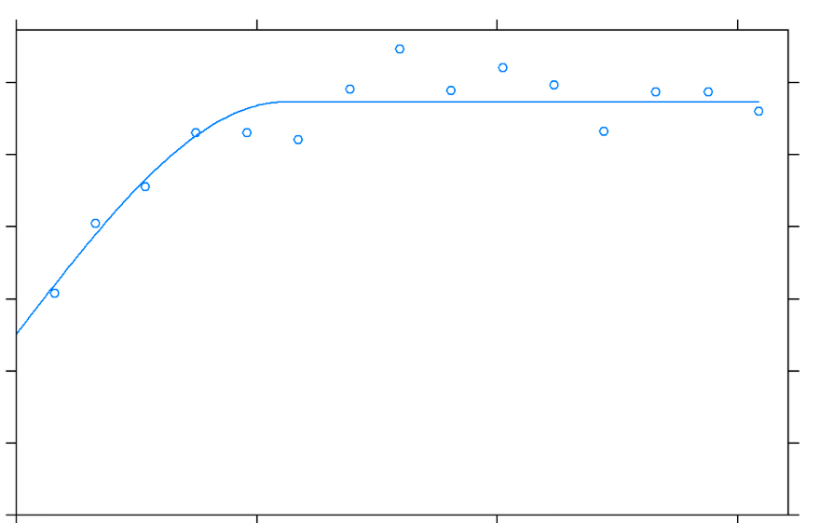
Variogram
15°
Variogram:
15° Variogram:
Lag
Notes:
So for instance, let’s say I want to compute a 15 degree variogram. *click* So I take a bunch of points where I have measurements of chocolateyness. Then I find which pairs are 15 degrees apart. And those are my set S. *click* Now here’s the formula again for my estimated variogram. And I just compute the change in chocolateyness, squared, averaged over all these pairs. And then that gives me a point on the 15 degree variogram. *click* This point right here. The lag was this distance in the 15 degree direction, and then the variogram value was this big. And we do this for all the different lags, and then for several different directions besides 15 degrees obviously. And that’s it. Super cool.

Slide 54
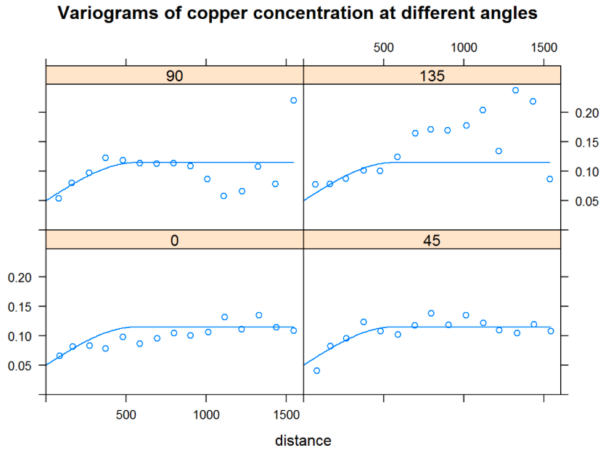
Lag
Notes:
So here’s an example from Steve’s variogram demo, and instead of chocolateyness it’s copper concentration. And there are 4 variograms here. The angles are the numbers 0, 45 degrees, 90, and 135. Hmm, something’s fishy with the fit on that 135 degree variogram. Looks like we mght not have had enough data in S to estimate that one correctly. The variograms for the other directinos look pretty similar to each other. Which is nice because then you only have to show people one variogram and say that it works for all different angles.

Slide 55
Variogram
Variogram:
“Omnidirectional”
Variogram:
Lag
Notes:
So you could have an *omnidirectional variogram* that words for all the angles at the same time. And you would just compute lags in any direction, using euclidean distance.

Slide 56
Variogram
Covariance:
Variogram:
“Omnidirectional”
Variogram:
“Sill”
Lag
Notes:
One thing I didn’t mention is that a variogram is everything you need in order to get an estimate of the covariance between y and its lagged version. In fact you can essentially get the covariance using the negative of the variogram. The sill is just the flat part over here.

Slide 57
Variogram
Covariance:
“Omnidirectional”
Covariance:
Lag
Notes:
So you could think of flipping the variogram upside down to get something that is related to the covariance.

Slide 58
Variogram
From the variogram, we need one thing for Kriging/Gaussian Processes:
A way to estimate pairwise covariances
Notes:
Now I’m building up to Kriging or Gaussian processes here. In order to get things ready for kriging, we need a couple of things from the variogram. *click* we need a way to estimate pairwise covariances, which is exactly what that variogram gives us. We need to be able to calculate *click* a full matrix of pairwise covariances for all the pairs of points in my dataset. That’s this K neighbors. Now, we’re going to try to estimate the labels at new point x, so I need to be able to estimate the variance of the label at point x. *click* so that’s right here. And then last thing, I need to be able to estimate *click* the covariances between the new point x and all of the points in my dataset, so that’s a vector, called Kx. Got it? We need these three ingredients, Kneightbors, Kx and K(x,x).
*ad lib* I have to tell you something before we go further. I love this idea of the variogram and estimating it in this totally nonparametric way that I was telling you about. But many people, particularly in the ML world, take a shortcut and estimate it in a much simpler, but possibly less elegant way.

Slide 59
Variogram
From the variogram, we need one thing for Kriging/Gaussian Processes:
A way to estimate pairwise covariances
Notes:
They just use a gaussian kernel. This just says that the covariance decreases according to the gaussian pdf, with a particular bandwidth. In all directions. So no variogram, no cool estimation for different angles, none of that. Neither one is right or wrong, though obviously the variogram is more data-driven, possibly will fit better, but the gaussian pdf is definitely simpler.

Slide 60
Variogram
From the variogram, we need one thing for Kriging/Gaussian Processes:
A way to estimate pairwise covariances
Notes:
And no matter whether you do the variogram way or the gaussian pdf to get the covariances, you still need these three pieces, the *read* so this is going to be *click*

Slide 61
Variogram
From the variogram, we need one thing for Kriging/Gaussian Processes:
A way to estimate pairwise covariances
Notes:
A matrix of numbers, a vector of numbers, and a single number.

Slide 62
Variogram
Semi-Variogram:
Variogram:
Semi-variogram is just twice the variogram.
Notes:
One last piece of terminology, a semivariogram is just the variogram without that confusing ½. That ½ just makes me want to laugh. Anyway, we’re all set to go on to Kriging and Gp.

Slide 63
Kriging/Gaussian Processes/Spatial Regression
Part 1

Slide 64
Kriging/Gaussian Processes/Spatial Regression
Remember, we got this from the variogram, or a formula.
Notes:
This topic is really important. This technique gets used everywhere. That’s probably why it has 3 different names, it’s because it was invented and reinvented by different people. The three things we need are what we got from the variogram or the covariance estimation. Kneighbors, Kx, or kxx.

Slide 65
Kriging/Gaussian Processes/Spatial Regression
Remember, we got this from the variogram, or a formula.
Notes:
A matrix, a vector and a number.

Slide 66
Kriging/Gaussian Processes/Spatial Regression
Remember, we got this from the variogram, or a formula.
Notes:
now, *click*

Slide 67
Kriging/Gaussian Processes/Spatial Regression
There are two ways to get the same method, 1) maximum likelihood, and 2) optimization. Start with optimization (“simple kriging”).
label at point x
trend
weights for neighbors that depend on x
residuals for the neighbors
Notes:
There are actually 2 different ways to derive this method, and they actually lead to the same exact result. We could do either maximum likelihood, or optimization. Kriging I think of as the optimization version, whereas gp I think of as maximum likelihood. In both cases the model for the label y given x has the same form. *click* Again think of y as the label, which you’re trying to estimate. So this is like copper levels, or chocolate levels, or whatever is varying in space that you want to estimate. Y is the sum of a trend, *cliick* , plus a weighted sum of information computed from the neighbors. In particular, we sum up how far away each neighbor is from the trend *click*, and weight the neighbors *click*, and that’s how far we think y(x) is from the trend. The weights are non trivial, we have to figure those out. If you have a bunch of neighbors that are highly correlated, you don’t need to pay attention to all of them, so these weights are kind of tricky business.

Slide 68
Kriging/Gaussian Processes/Spatial Regression
?
label at point x
trend
weights for neighbors that depend on x
residuals for the neighbors
Notes:
So here’s the picture. So how do we get our prediction for y at this point? I look at all the neighbors, and I figure out how far above the trend the neighbors are. *Click* And I assume that I’m about as far above the trend as my neighbors. So I compute a weighted average of how far my neighbors are from the trend. Neighbor I get a weight of lambda x, I *click* because the weight is for a particular x and a particular neighbor i of x.

Slide 69
Kriging/Gaussian Processes/Spatial Regression
Notes:
The questions of course that remain are how do I get mu and how do I get the lambdas for a particular x? That’s what the rest is about.

Slide 70
Kriging/Gaussian Processes/Spatial Regression Part 2
Notes:
The questions of course that remain are how do I get mu and how do I get the lambdas for a particular x? That’s what the rest is about.

Slide 71
Kriging/Gaussian Processes/Spatial Regression
Notes:
Now we’ve introduced the form of y, and we need to figure out how to get the parameters mu and the lambdas

Slide 72
Kriging/Gaussian Processes/Spatial Regression
Kriging estimates trend by the empirical mean of the samples.
Notes:
*click read* So you can just get rid of it by normalizing everything to 0 and assuming the mean is 0.

Slide 73
Kriging/Gaussian Processes/Spatial Regression
Kriging minimizes variance of this.
Variance of prediction error
Kriging minimizes variance by setting derivatives to 0.
Notes:
*the prediction error is just what we predicted minus the truth.
*And the job of kriging is to minimize the variance of this prediction error.
*I can rewrite the prediction error to make things a little tiny bit easier, by adding 0 in disguise, so that I get distances from the mean, which I could call remainders.
*So I have the estimated remainder and the true remainder here.
*Now again, kriging tries to minimize the variance of the prediction error, so we’ll call that sigma^2. And we’ll calculate it now. Remember the prediction error is Rhat - R
*Now if you want to compute the covariance of one rv minus another, it’s always this formula. This is the basic formula from probability of the covariance of the sum of 2 rv’s, except that one of them is negative so we get subtraction.
*Now we can plug in the formula up at the top here into the formulas for the variance and covariance and we get this.
*According to kriging, we minimize the variance, so to do that we set all the partial derivatives to 0. And this formula comes out when I take the derivative for the first component of lambda.
*Look at this for a second. First thing, cancel the 2’s. Next thing – remember that we have to do this for all components of lambda, this one is just for lambda1. So we can write this in matrix vector notation very simply. *click*
variance of prediction error is estimated using neighbors
the calculation of variance used the equation on the top.

Slide 74
Kriging/Gaussian Processes/Spatial Regression
Setting all derivatives to 0:
Kriging minimizes variance by setting derivatives to 0.
Notes:
And it looks like this. So this is the same exact equation as this one down here, it’s just that it’s written in matrix notation, and it holds for all the lambda’s, not just lambda 1. *ad lib*
Just to remind you of the sizes of these things,

Slide 75
Kriging/Gaussian Processes/Spatial Regression
neighbors x neighbors
1 x neighbors
1 x neighbors
Setting all derivatives to 0:
Kriging minimizes variance by setting derivatives to 0.
Notes:
we have one lambda for each neighbor, so it’s a vector, 1 by the number of neighbors. Then *ad lib*

Slide 76
Kriging/Gaussian Processes/Spatial Regression
Solving:
Setting all derivatives to 0:
Kriging minimizes variance by setting derivatives to 0.
Notes:
Now, let’s multiply both sides by Kneightbors inverse on the right.
We can do inverses since we made absolutely sure that Kneighbors was positive definite. And now we’ve solved for lambdax. Which is great by the way.

Slide 77
Kriging/Gaussian Processes/Spatial Regression
Solving:
Notes:
We got it. This is the fundamental thing we were trying to get for kriging.

Slide 78
Kriging/Gaussian Processes/Spatial Regression
Solving:
Variance of prediction error
Notes:
So just to remind you, kriging makes predictions according to this formula. So if you can estimate mu, which we did by taking the sample mean, and if we got lambdax from this formula, we have everything we need to make predictions. We just need the labels of the neighbors, which are the yi’s and we can plug everything in and make a prediction no matter what x is. So it’s great! One awesomely cool thing about kriging is that you can get an estimate for the prediction error variance. And that comes from the formula for the variance we came up with in the first place and took derivatives of it to get that formula up there. So we got the whole thing. We can compute everything here, *ad lib* so we’re all good.

Slide 79
Kriging/Gaussian Processes/Spatial Regression
Variance of prediction error
Notes:
I just want to reinforce this point that we can compute everything in these three equations. All we need is * K neighbors, which is a matrix, Kx, which is a vector of K of x with all the neighbors, and then kxx which is just a number.

Slide 80
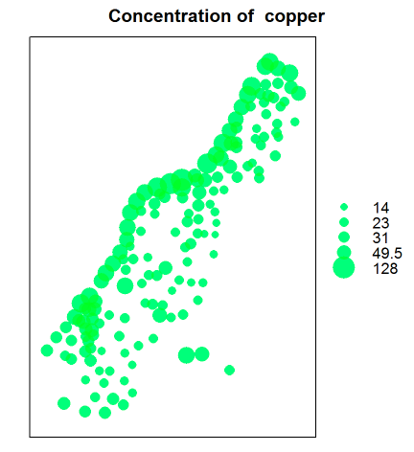
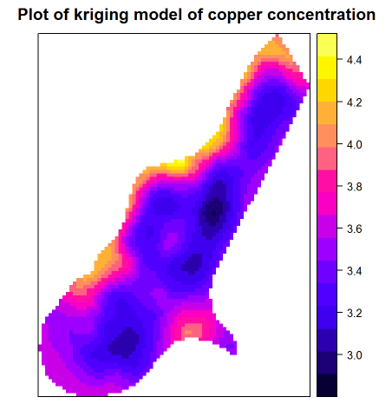
Notes:
Here is the data from the demo. This is just the data on the left. This is land. The concentration of copper, which is the label, is represented by the size of the ball. So we should expect to see higher copper concentrations over on this coast here, maybe a little higher concentration over here.
* and here’s the kriging result, and yea you can see the concentrations doing exactly what we hoped they would do, The higher concentrations are over here on the coast, and this little blob of high concentration is over there, and the lower concentrations are over here. And the estimated copper concentrations come from solving the equation for lambda on the previous slide. At each point.

Slide 81
Kriging/Gaussian Processes/Spatial Regression
Variance of prediction error
Remove the mean and substitute the red equation:
Variance of prediction error
Notes:
There’s one more thing I need to do before we move on. I need to simplify the calculation a little bit. So before, we derived lambda, and estimated mu just as the sample mean. And then we plugged them into these two equations that we saw earlier. But I can
* remove the mean (I could put it back in whenever I want) and substitute the formula for lambda right in there, and simplify a little, and then I get these two equations here. Now just to remind you, the way we got these equations was by minimizing the variance of the prediction error. But the same exact equations are going to show up in a minute. So you could just memorize them and then you’ll know when I put them up later. Oh wait, you could take a screen shot right there, so you can compare. Or you could just believe me when you see them again.

Slide 82
Kriging/Gaussian Processes/Spatial Regression
Maximum likelihood interpretation: leads to the same math.
Notes:
Ok start over. We’re going to derive the kriging equations again, starting with maximum likelihood. I should stop calling it kriging and now call it gp.
Start by assuming that the labels come from a normal distribution with mean 0. I know it’s weird to have mean 0, but the people who do this assume that you can estimate the mean separately so that you can add the trend back in. What these guys want is the model for the covariances. So we assume that the labels come from a normal, with mean 0 and this covariance matrix. Now look at the structure of this.
All the top rows are for the neighbors, and the very last row is for the new xy pair where you want to make a prediction.
These – are the covariances of the neighbors with each other.
These – are the covarances of the neighbors with x. And so are these on the bottom.
This last one is the variance of x, or the covariance of x with itself.

Slide 83
Kriging/Gaussian Processes/Spatial Regression
Maximum likelihood interpretation: leads to the same math.
Notes:
I’m just going to simplify the notation by putting it in matrix vector.
*ad lib and point*

Slide 84
Kriging/Gaussian Processes/Spatial Regression
Maximum likelihood interpretation: leads to the same math.
Notes:
* Now it is possible to calculate (I’m not going to do it but it is possible) that according to this model up here, that the distribution of y *given* the value of the neighbors labels is normal, with this mean and this variance. So up here we have the distribution of all the y’s. Down here we just have the distribution of the new y we care about given all the other y’s. So if this model up here is true, this thing down here is true.
This says that the mean of y should be estimated just like this
and the variance should be estimated just like that. And that’s

Slide 85
Kriging/Gaussian Processes/Spatial Regression
Maximum likelihood interpretation: leads to the same math.
Notes:
the whole thing.

Slide 86
Kriging/Gaussian Processes/Spatial Regression
Maximum likelihood interpretation: leads to the same math.
From optimization:
Variance of prediction error
Notes:
Let me put back up here the thing I told you to memorize or take a picture of, This is the result from the optimization kriging approach we developed earlier. and check it out, it’s exactly the same. So we did it. So now you can talk to a hydrologist doing kriging, or you can talk to a machine learning person doing gp, and you’ll be able to understand what they are talking about either way.

Slide 87
Notes
Excellent modeling tool.
The dimensionality of the input space does not matter. We just need to be able to estimate covariances k(x,x).
k can be arbitrarily complicated.
We can easily adapt the technique to use different local means.
Vanilla Gaussian Processes scale badly (cubically) in the number of points. Can’t do it for more than a few thousand points without having to use fancier techniques.

